Slide 1
Probabilistic Modelling and Autoencoders

Slide 2
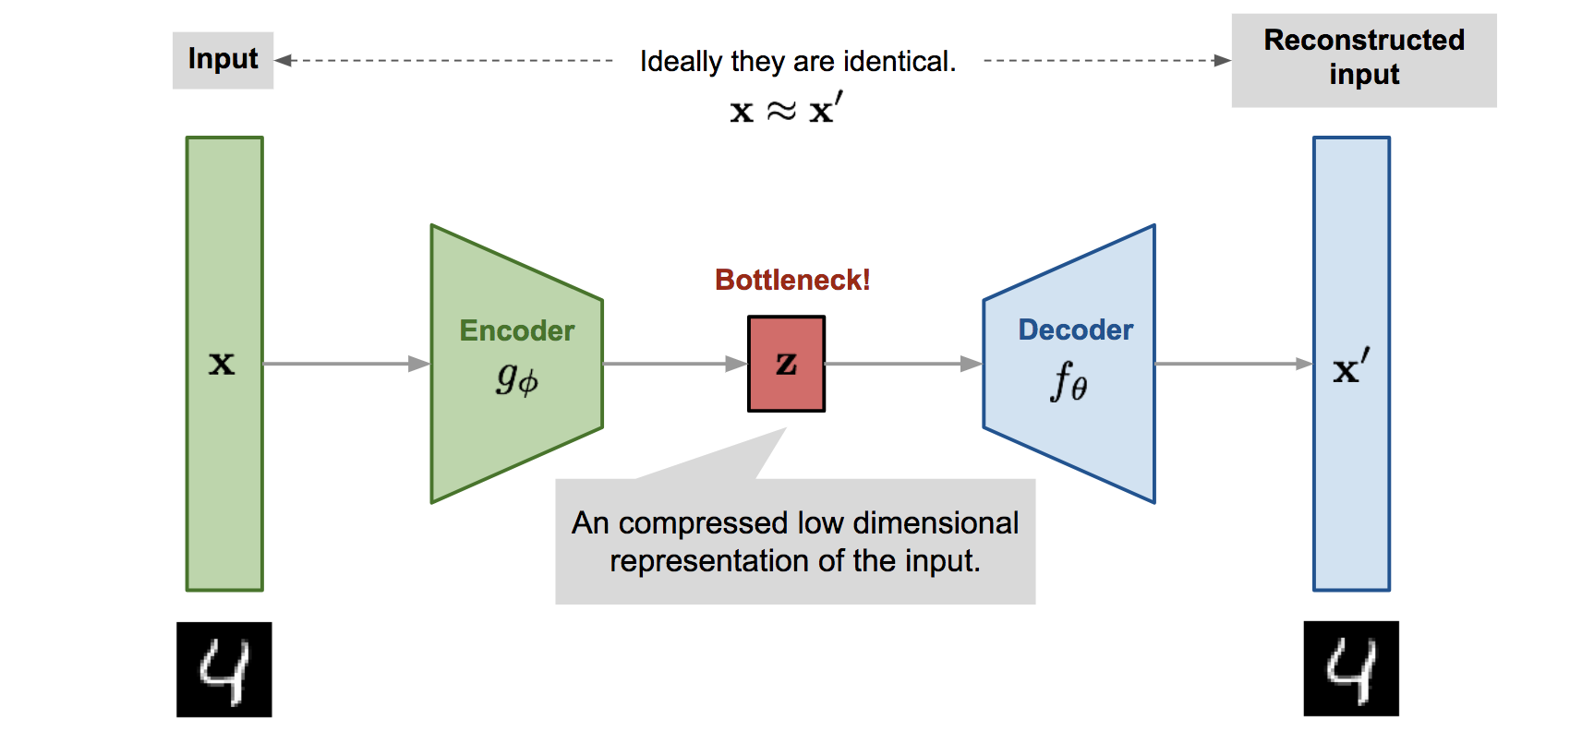
Autoencoder:

Slide 3
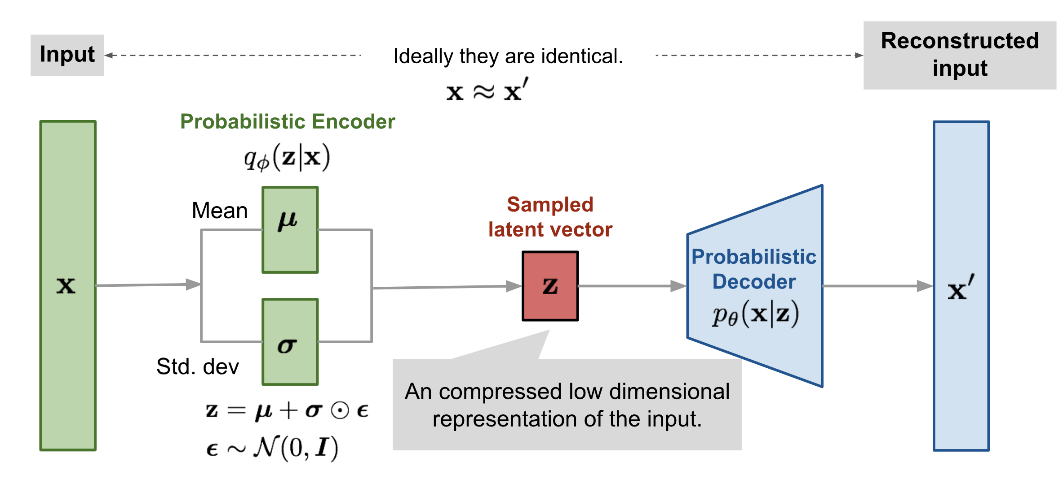
Variational Autoencoder (VAE):

Slide 4
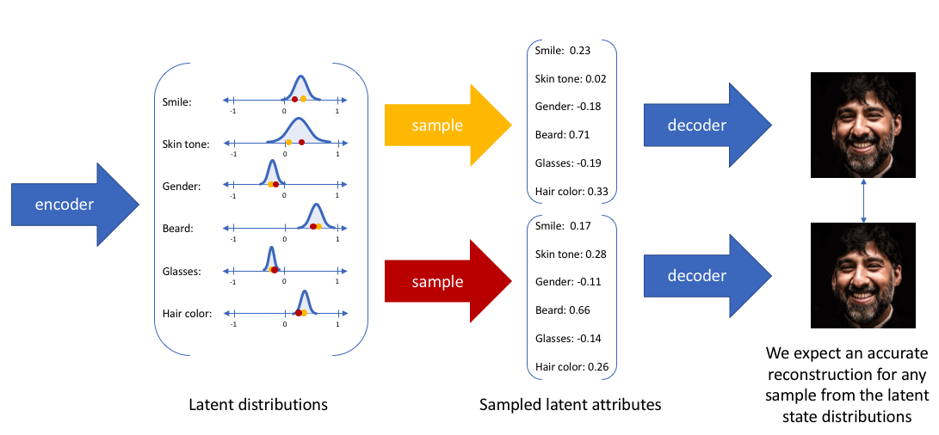
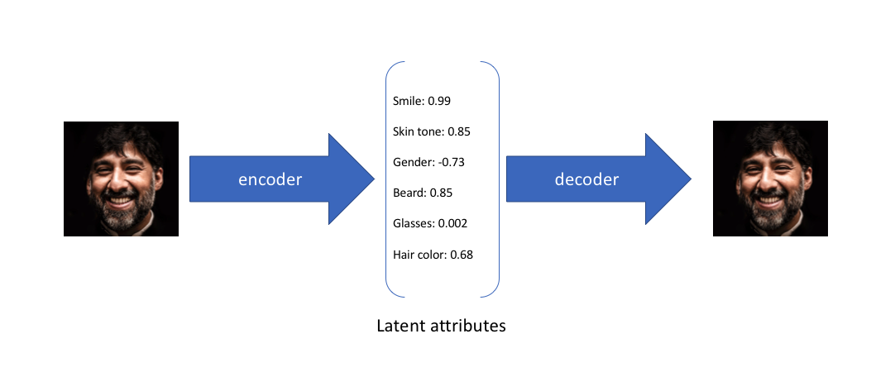
VAE
AE:

Slide 5
Reconstruction Loss:
L(θ, φ; x^{(i)} ) = −D_{KL}(q_{φ}(z |x (i) )|| p_{θ}(z)) + E_{qφ(z|x(i))} [log p_{θ}(x^{(i)} |z) ]
where,
D_{KL} is the Kullback-Leibler divergence
E_{qφ(z|x(i))} [log p_{θ}(x^{(i)} |z) ] is the log likelihood

Slide 6
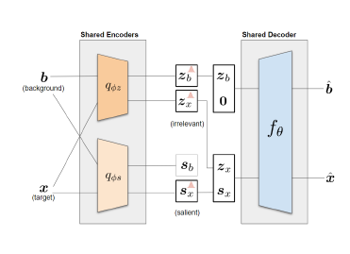
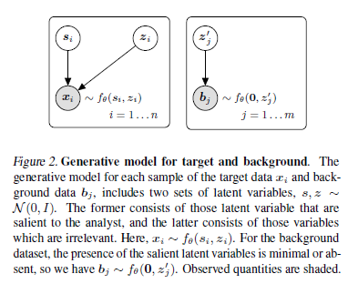
Contrastive VAE:

Slide 7


Log likelihood for target and background dataset:
For the target dataset, we have the following likelihood lower bound
For the likelihood of the background dataset, we have:

Slide 8

Correlation term:
Total correlation (TC) term is added to the objective function for the target dataset,

Slide 9
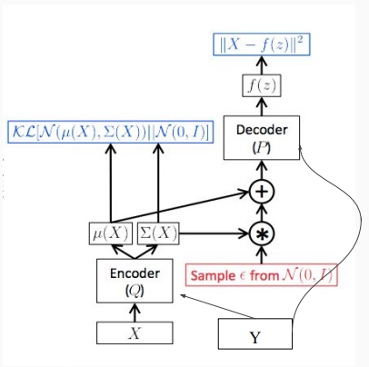
Conditional Variational Autoencoder (CVAE):
L(θ, φ; x^{(i)} ) = −D_{KL}(q_{φ}(z |x (i), Y )|| p_{θ}(z)) + E_{qφ(z|x(i))} [log p_{θ}(x^{(i)} |z, Y) ]
where,
D_{KL} is the Kullback-Leibler divergence
E_{qφ(z|x(i))} [log p_{θ}(x^{(i)} |z, Y) ] is the log likelihood

Slide 10





Multimodal Generative Models:
x1, x2, ..xM – M modalities
x1
µ1
$$q_{∅}$$
PoE
σ1
x2
µ2
$$q_{∅}$$
σ2
µ
Reconstructed Output
z
$$p_{θ}$$
.
.
.
σ
Probabilistic Decoder
xM
µM
$$q_{∅}$$
σM
Product of Experts
Probabilistic Encoders

Slide 11
L(θ, φ; x^{(i)} ) = −D_{KL}(q_{φ}(z |x , C)|| p_{θ}(z)) + $Σ_{k}$ E_{qφ(z|x(i))} [log p_{θ}(x^{(k)} |z, c) ]
x1
µ1
$$q_{∅}$$
PoE
c1
σ1
C = [c1, c2, . . . cK]
x2
µ2
$$q_{∅}$$
c2
σ2
µ
Reconstructed Output
z
$$p_{θ}$$
.
.
.
σ
Probabilistic Decoder
xK
$$q_{∅}$$
µM
cK
σM
Product of Experts
x1, x2, ..xK – K classes

